Slide 1

Understanding Graph Databases
Exploring NEO4J and its unique features
PPOL 5206 – Spring 2025
Notes:
AI-generated content may be incorrect. --- In this presentation, we will explore the fundamentals of graph databases, focusing on NEO4J, a leading graph database platform. We will discuss how graph databases differ from traditional relational databases and introduce the Cypher query language.

Slide 2
Last Week
Deep dive into relational databases
Database theory
Joins
Data engineering vs data science (OLTP vs OLAP)

Slide 3
Today’s Agenda
Graph Databases
Neo4J
Cypher
Other Databases
AWS Cloud Services
RDS
Redshift

Slide 4
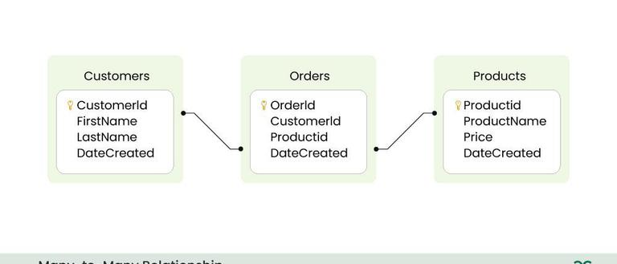
Relational Databases
Data is stored in tables
Relationships are defined in the schema
But…

Slide 5
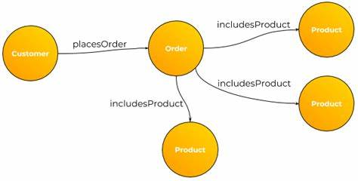
WHAT IF THE SCHEMA WAS STORED AS DATA…

Slide 6
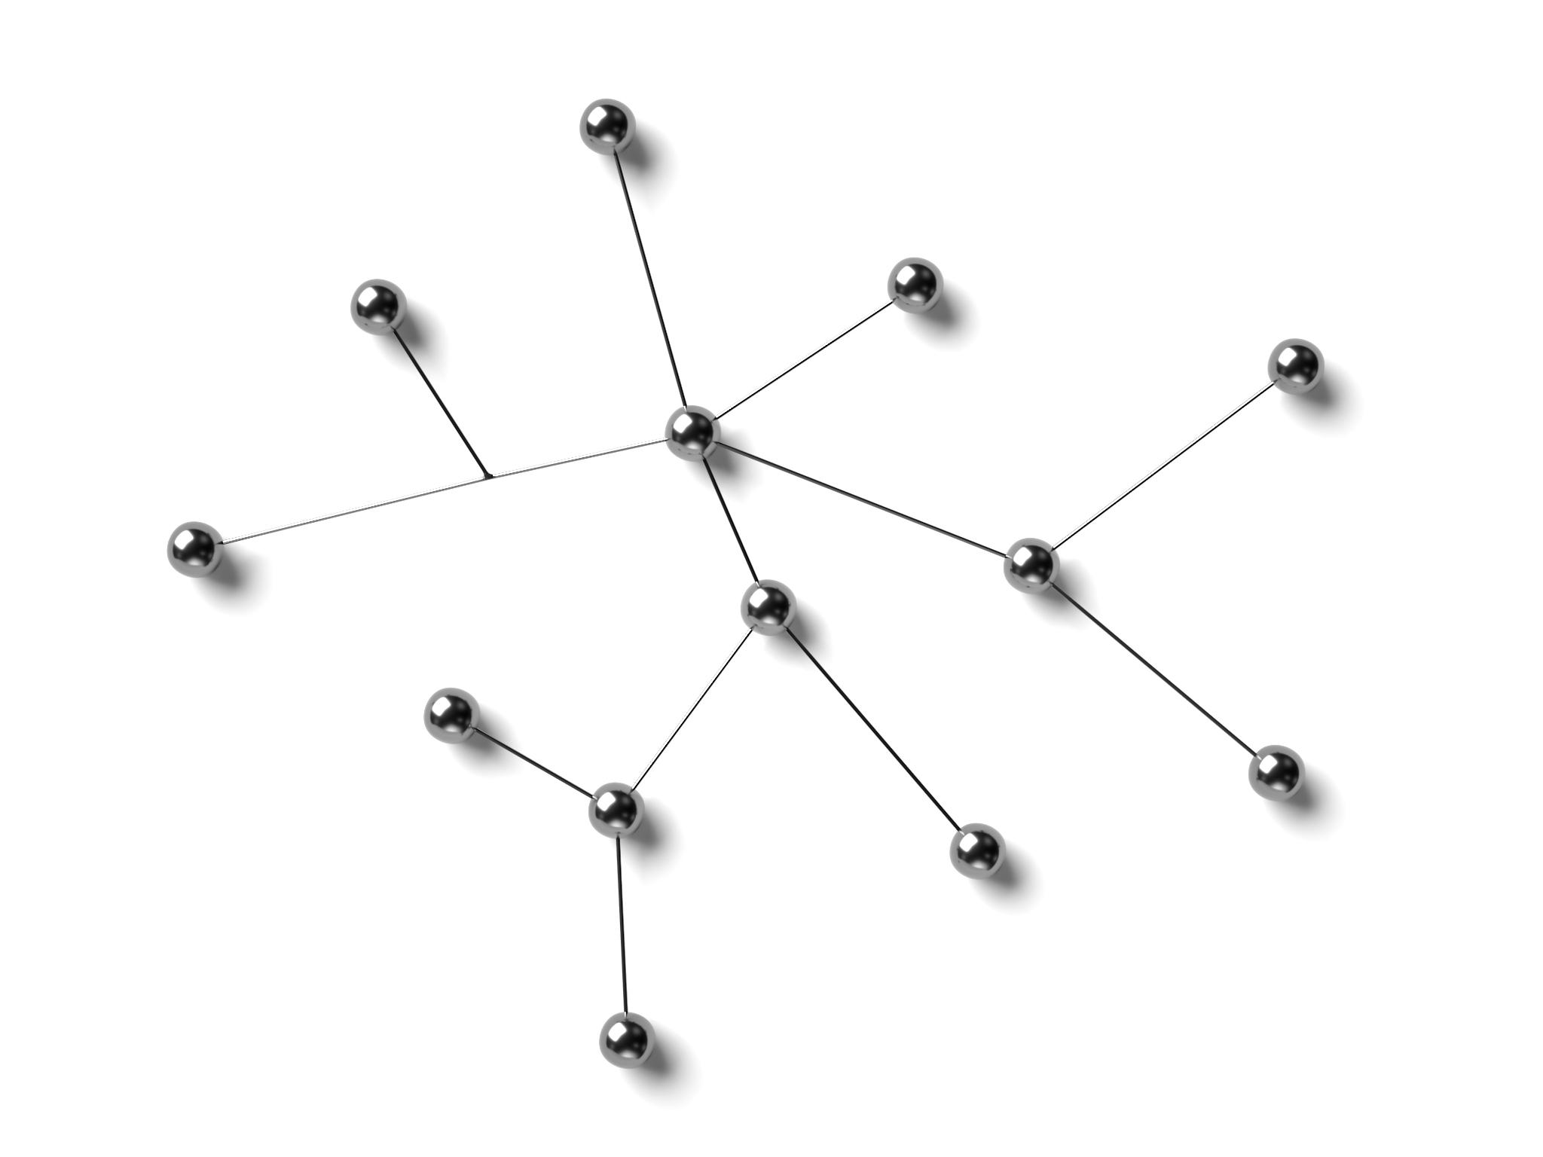
What are Graph Databases?
Definition of Graph Databases
Graph databases are specialized databases that utilize graph structures to represent data and their relationships effectively.
Relationships in Data
They excel in applications where complex relationships between data points need to be represented and traversed efficiently.
Ideal Applications
Graph databases are ideal for social networks, recommendation systems, and any application requiring deep relationship analysis.
Notes:
Graph databases are designed to represent and traverse relationships between data points. They use graph structures with nodes, edges, and properties to store data, making them ideal for applications with complex relationships.

Slide 7
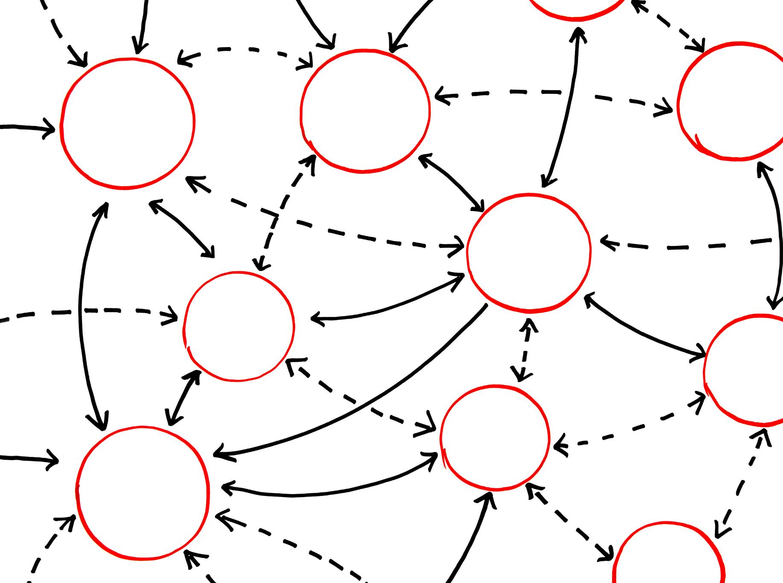
Benefits of Graph Databases
Efficient Relationship Handling
Graph databases excel in managing complex relationships between data points, making them ideal for interconnected data.
Flexible Schema Design
They allow for more flexible schema design compared to traditional databases, enabling easy modifications and adaptations. Merges OLTP and OLAP.
Powerful Querying Capabilities
Graph databases provide powerful querying capabilities to extract complex data insights quickly and efficiently.
Use Cases
They are particularly effective for use cases such as social networks, recommendation systems, and fraud detection.
Notes:
Graph databases offer several advantages, including efficient relationship handling, flexible schema design, and powerful querying capabilities. They excel in scenarios like social networks, recommendation systems, and fraud detection.

Slide 8
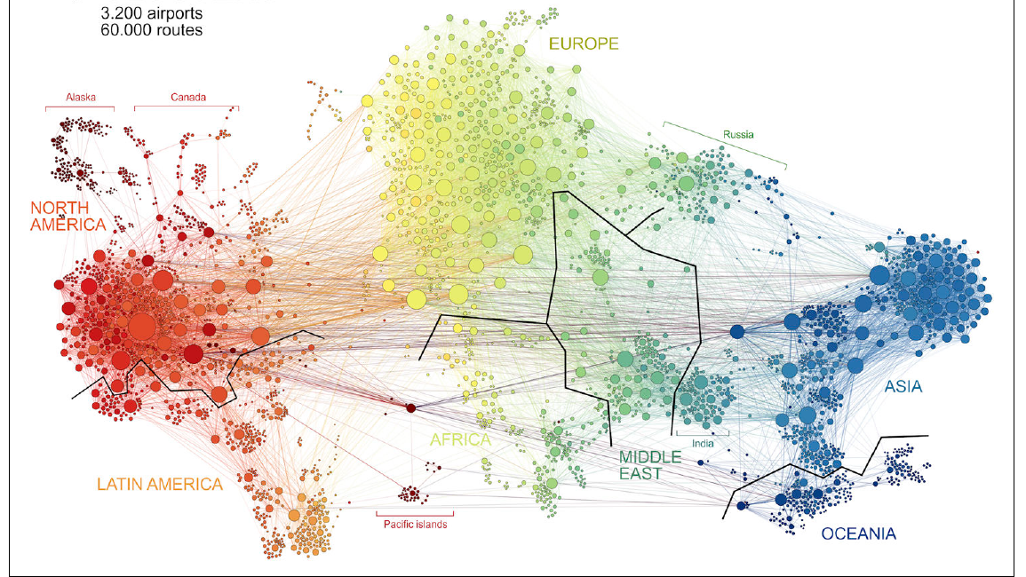
Notes:
Source: Figure 1.9

Slide 9
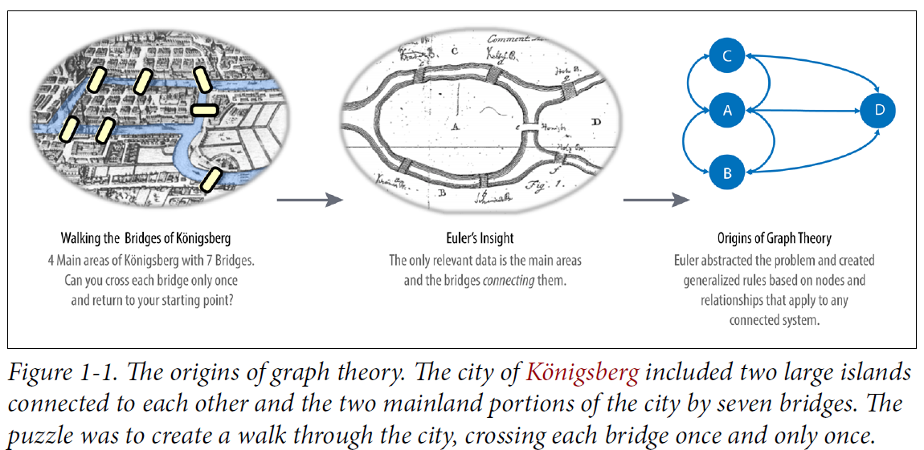
Euler’s Idea

Slide 10
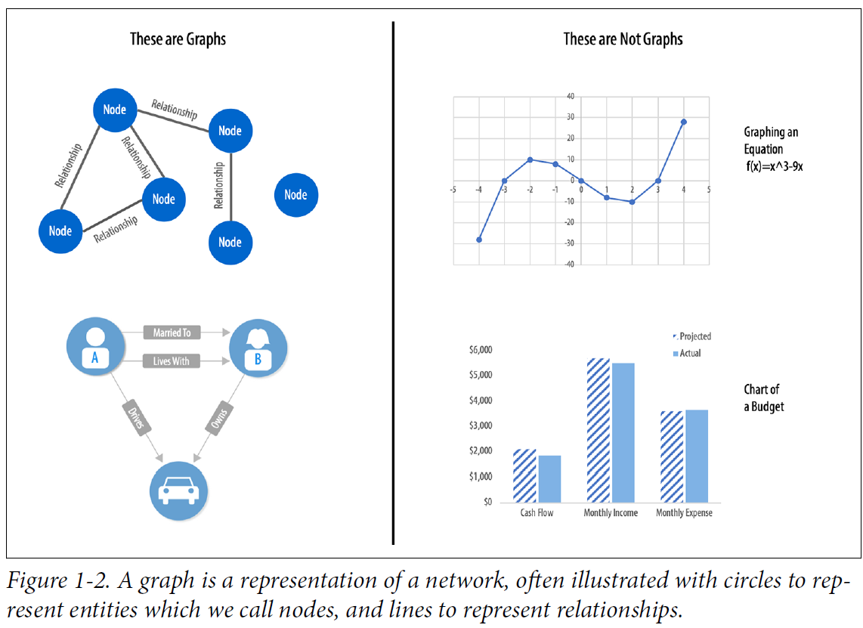
Graphs vs Charts

Slide 11
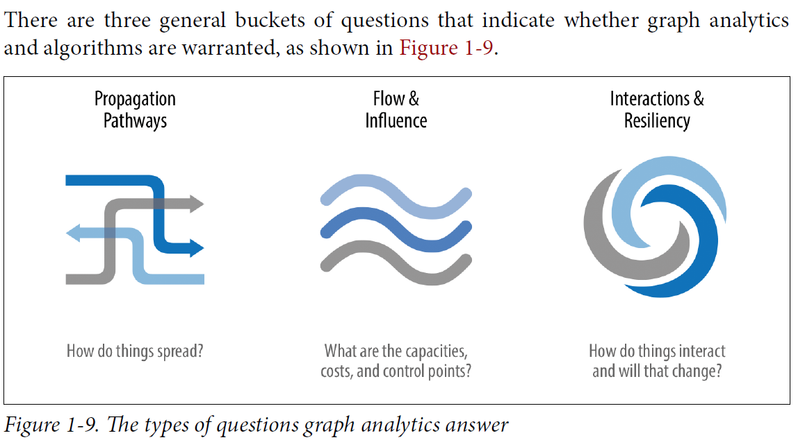
Graph problems are common

Slide 12
Graph-like problems I’ve worked on (with and without graphs)
Patent valuation
Networks of citations and inventors
Supply chain analysis
Organizational knowledge mapping

Slide 13
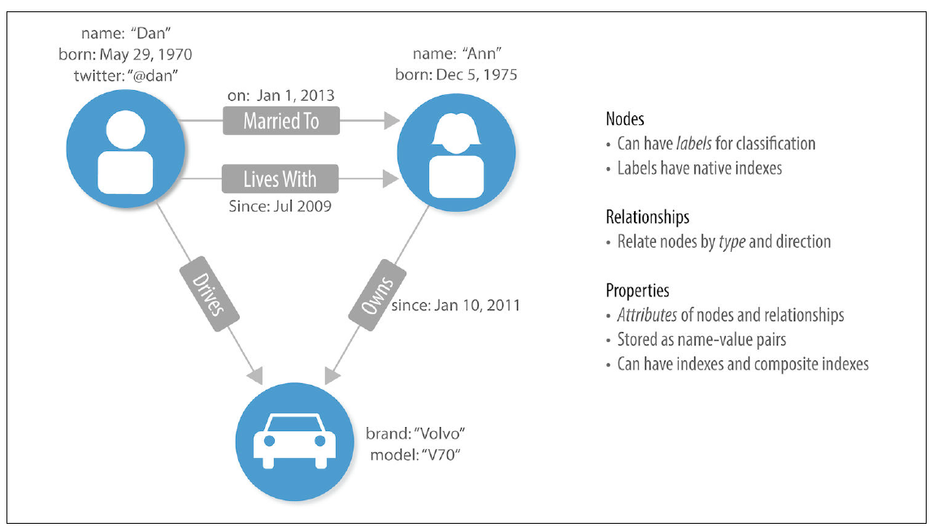
A Labeled Property Graph Model

Slide 14
Graph Terminology
Nodes (vertices):
Objects that make up a graph
Have labels and properties
Relationships (links, edges):
Connections between nodes
Have type and direction
Label:
Marks a node as part of a group (Person, Car)
Property:
Synonymous with attributes

Slide 15
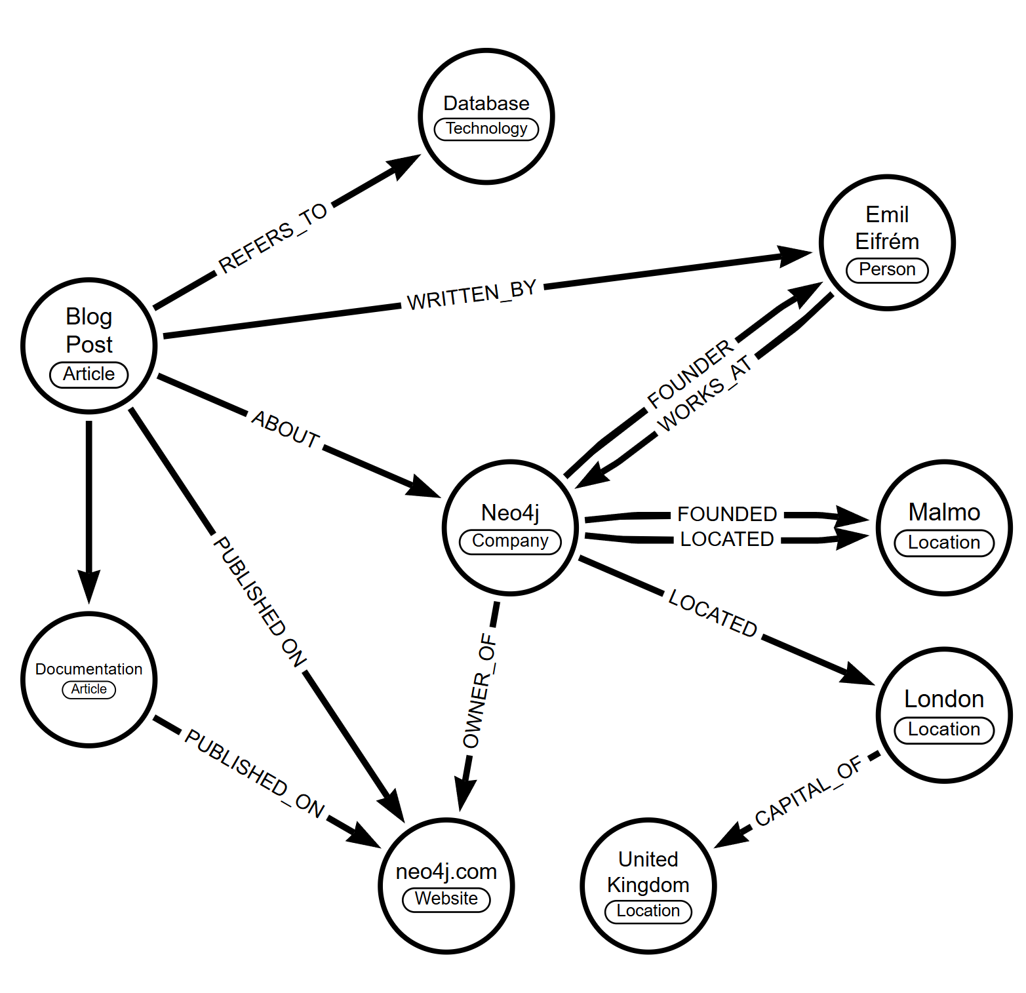

Slide 16
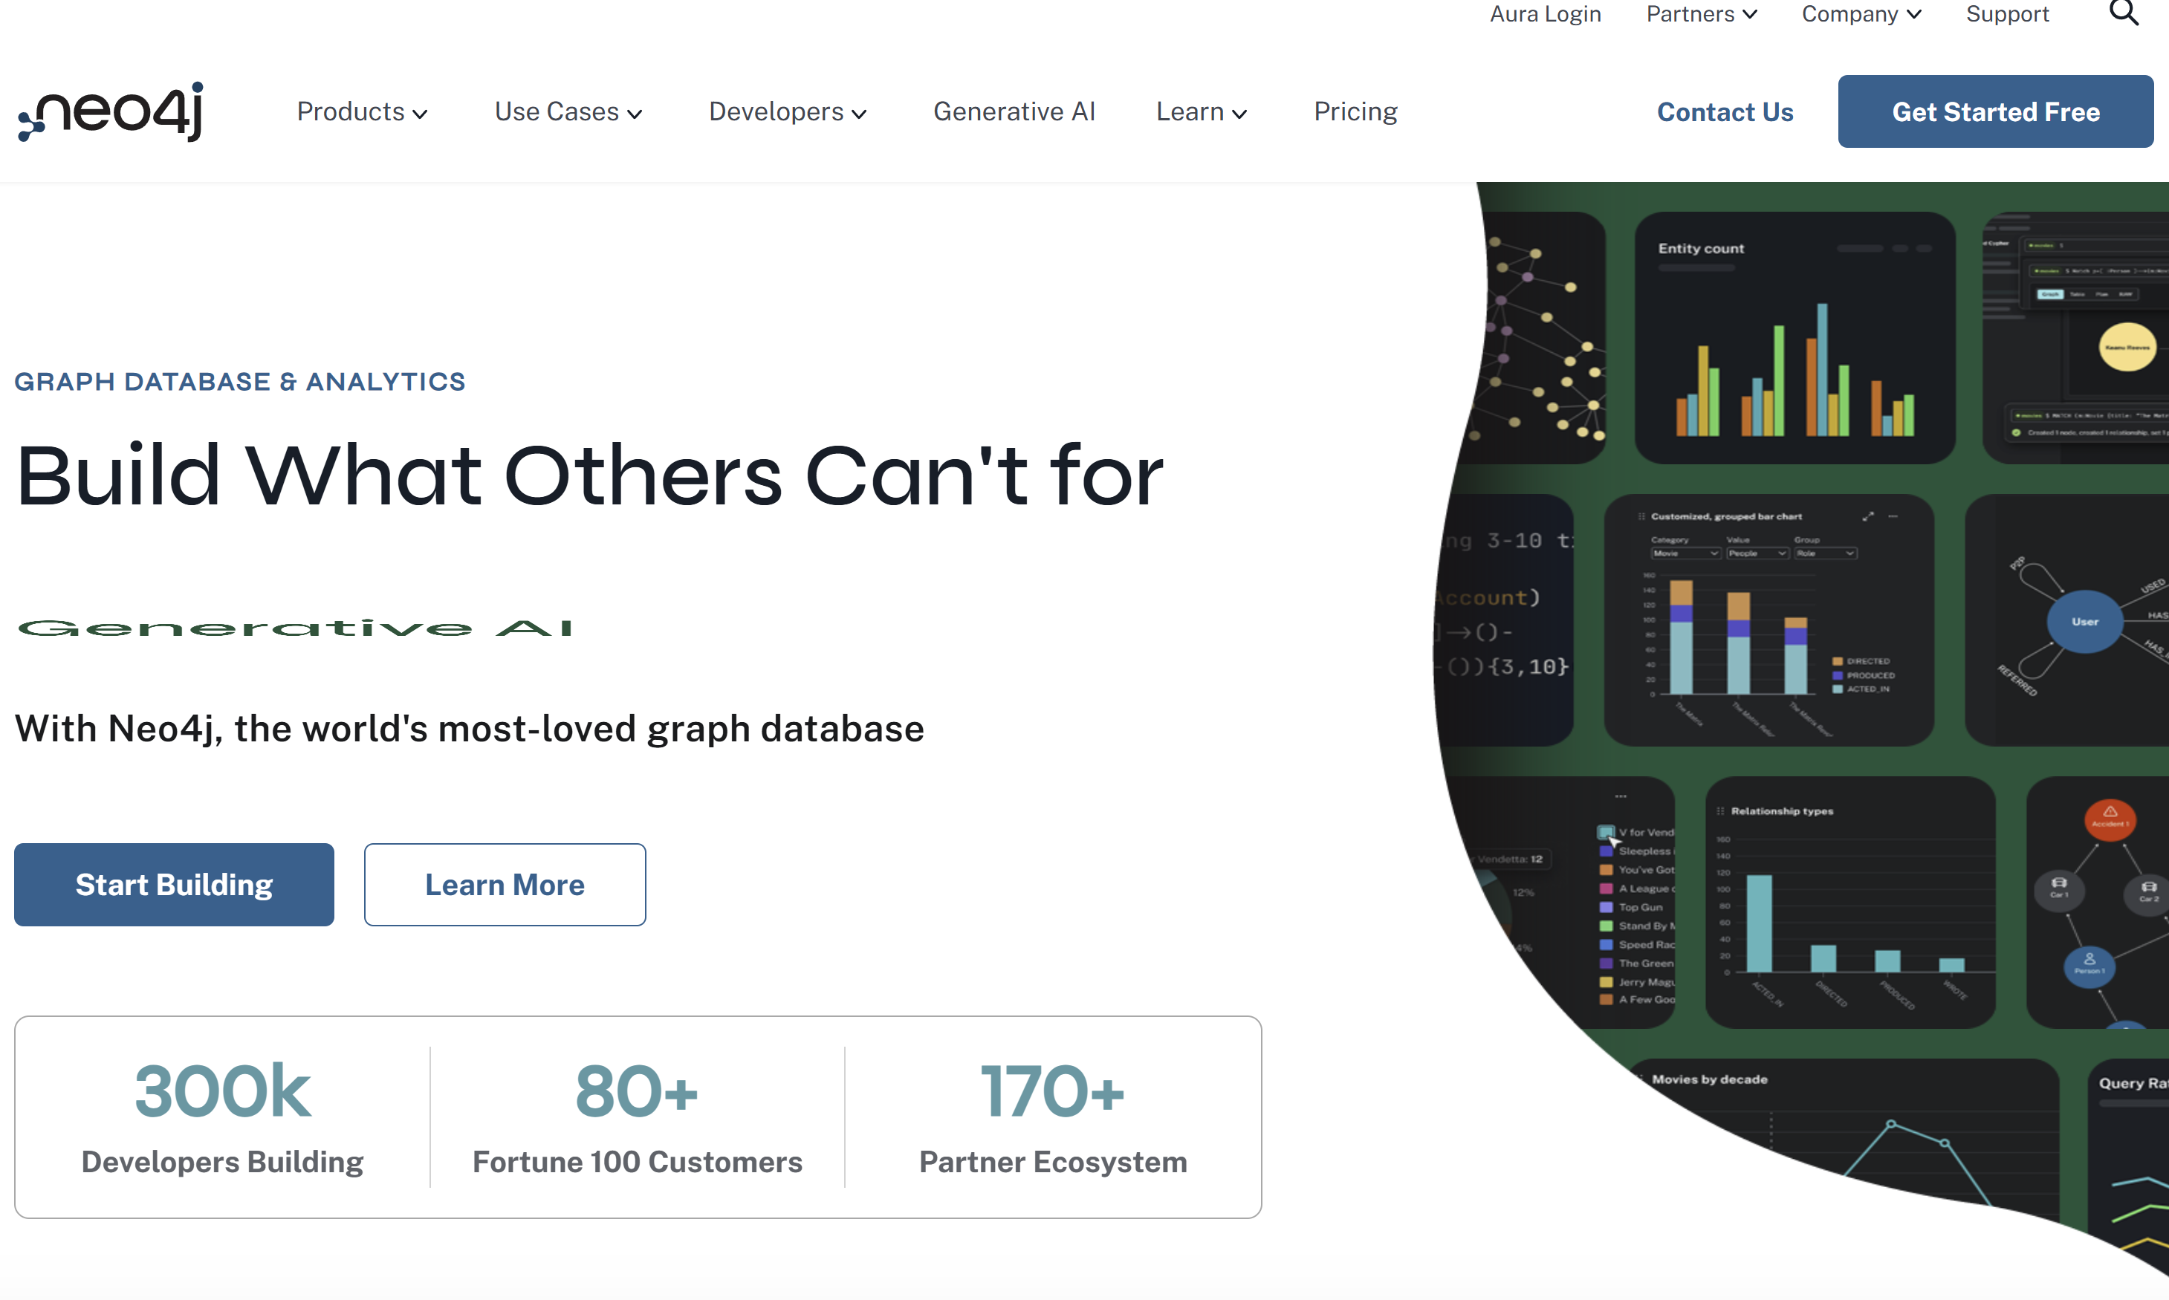
Most popular graph database: NEO4J
Examples: Neo4j Product Demos

Slide 17

Overview of NEO4J
Open-Source Graph Database
NEO4J is an open-source graph database that allows developers to build applications with a focus on data relationships.
ACID Transactions
NEO4J supports ACID transactions, ensuring data integrity and reliability during complex operations.
High Performance
The database offers high performance, especially in graph traversals, making it ideal for applications with complex queries. Scales at O(1)
Notes:
NEO4J is a popular open-source graph database that provides a robust platform for building applications that require complex data relationships. It supports ACID transactions and offers high performance on graph traversals.

Slide 18

NEO4J Use Cases
Social Networking
NEO4J is utilized in social networking applications to analyze and visualize relationships between users, enhancing user engagement.
Network and IT Operations
In network and IT operations, NEO4J manages and monitors complex network topologies, improving efficiency and troubleshooting.
Real-time Recommendations
NEO4J powers real-time recommendation systems by analyzing user preferences and behaviors to provide personalized suggestions.
Knowledge Graphs
Knowledge graphs created using NEO4J help organizations connect and visualize complex information, improving decision-making processes.
Notes:
NEO4J is widely used in various industries for applications like social networking, network and IT operations, real-time recommendations, and knowledge graphs. Its ability to manage highly connected data effectively makes it a favored choice.

Slide 19

Graph Databases vs. Relational Databases
Database Structures
Relational databases use tables and rows to organize data, making it suitable for structured queries.
Graph Representation
Graph databases utilize graph structures, which allow for more intuitive representations of complex relationships.
Query Efficiency
Graph databases enable efficient querying of relationships, reducing the complexity seen in traditional relational queries.
Notes:
Graph databases and relational databases serve different purposes. While relational databases use tables and foreign keys to represent relationships, graph databases leverage graph structures, allowing for more intuitive data representation and efficient querying of relationships.

Slide 20
Moving From Relational to Graph DBs
Rows become Nodes
Table Names become Node Labels
Columns become Node Properties
Joins or Foreign Keys become Relationships
Join between Suppliers and Products becomes a relationship named SUPPLIES (where supplier supplies product).
Join between Products and Categories becomes a relationship named PART_OF (where product is part of a category).
Join between Employees and Orders becomes a relationship named SOLD (where employee sold an order).
Neo4J Example: guides.neo4j.com/northwind/index.html

Slide 21
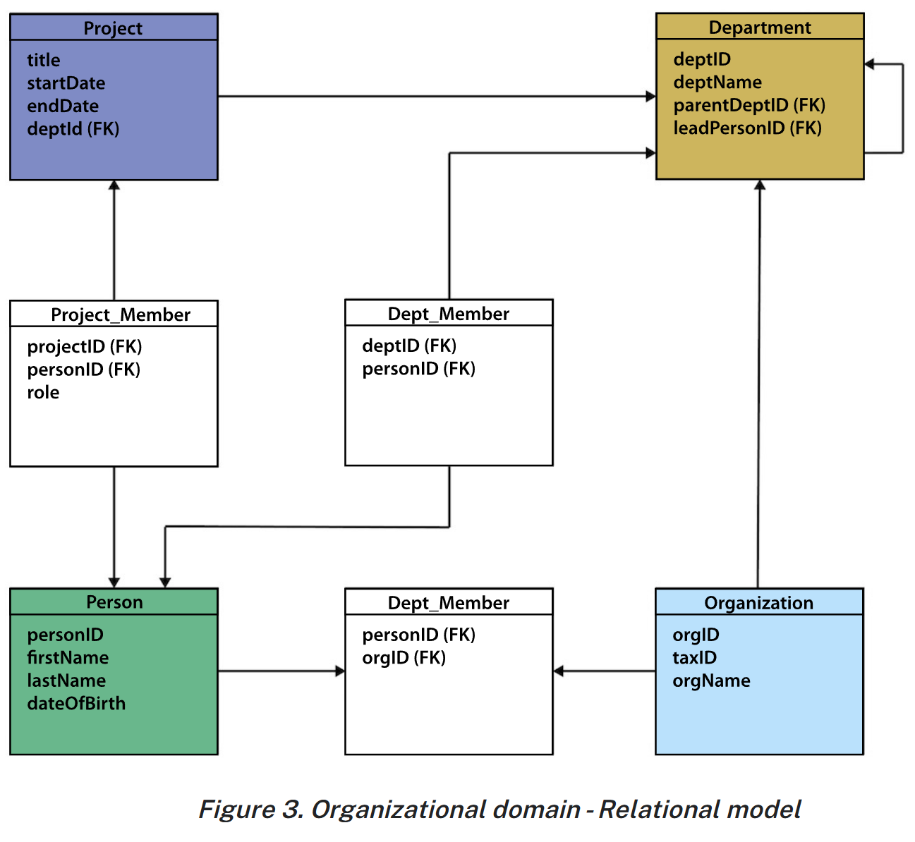

Slide 22
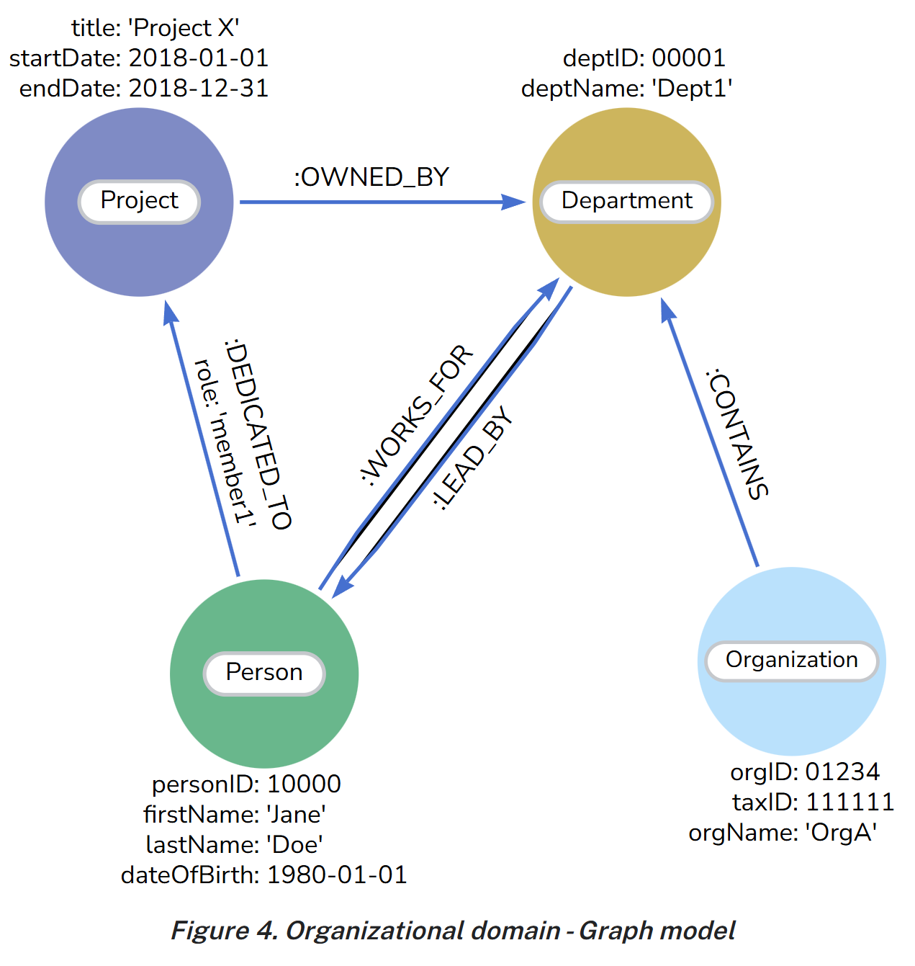

Slide 23

Comparative Analysis
Performance on Complex Queries
Graph databases often outperform relational databases for complex queries that involve relationships between multiple entities.
Schema Flexibility
Graph databases provide greater schema flexibility, allowing for easier modifications and adjustments as data evolves over time.
Handling Many-to-Many Relationships
Graph databases excel at managing many-to-many relationships, simplifying queries that involve interconnected data.
Notes:
In this slide, we will examine key differences between graph databases and relational databases, including performance on complex queries, schema flexibility, and ease of handling many-to-many relationships.

Slide 24

When to Use Each
Graph Databases
Graph databases excel in handling complex relationships between data points and adapting to dynamic schemas, making them ideal for interconnected data.
Relational Databases
Relational databases are best suited for structured data with clearly defined relationships, providing stability and consistency for transactional applications.
Notes:
Understanding when to use graph databases versus relational databases is critical. Graph databases are ideal for scenarios with complex relationships and dynamic schemas, while relational databases are best for structured data with well-defined relationships.

Slide 25

Introduction to Cypher
Graph Query Language
Cypher is specifically designed for querying graph structured data, making it easy to access relationships and connections.
Complex Traversals
Developers can express complex graph traversals simply with Cypher, enabling efficient data retrieval.
Declarative Syntax
Cypher's declarative nature allows users to specify what data they want rather than how to retrieve it, simplifying query writing.
Cypher Manual: Introduction - Cypher Manual
Notes:
Cypher is the query language for NEO4J, designed to work with graph structured data. It allows developers to express complex graph traversals easily. Cypher is declarative, allowing users to focus on the 'what' rather than the 'how'.

Slide 26
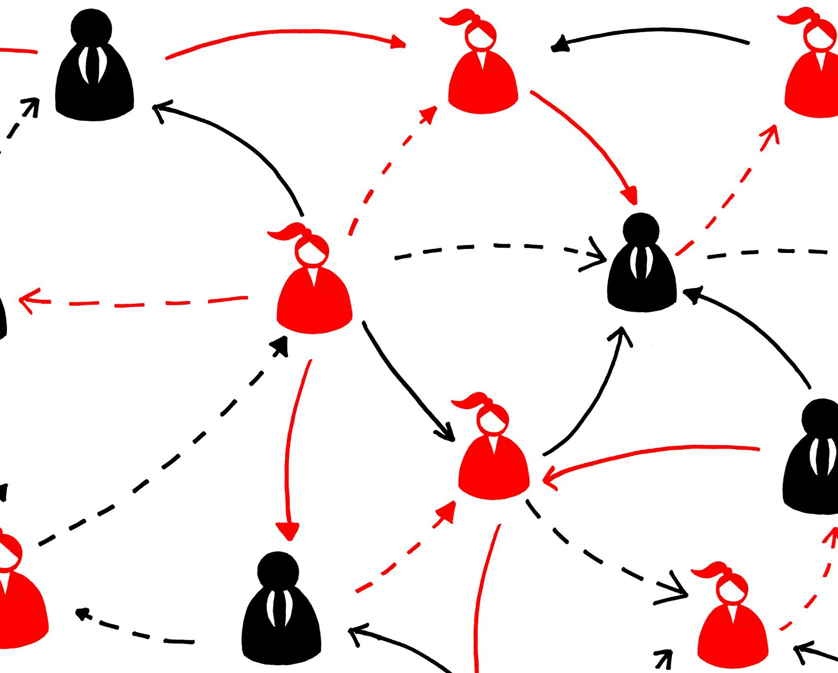
Cypher Examples
Querying Friends
To find all friends of 'Alice', use the MATCH query to retrieve connected nodes in the graph database.
Creating Relationships
You can create new relationships in the database by using the CREATE query to connect nodes.
Notes:
For example, to find all friends of a person named 'Alice', you can use the query: MATCH (a:Person {name: 'Alice'})-[:FRIEND]->(friends) RETURN friends. Additionally, to create a new relationship, you might use: MATCH (a:Person {name: 'Alice'}), (b:Person {name: 'Bob'}) CREATE (a)-[:FRIEND]->(b).

Slide 27
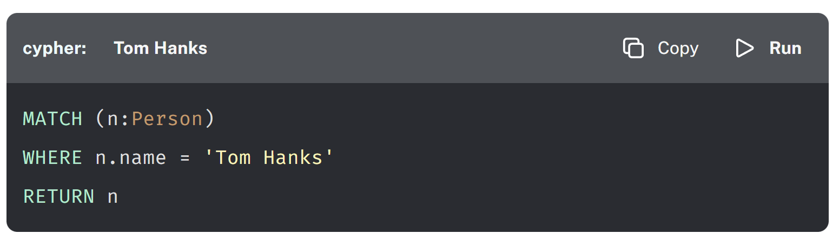
Find Person Node with Name Attribute “Tom Hanks

Slide 28
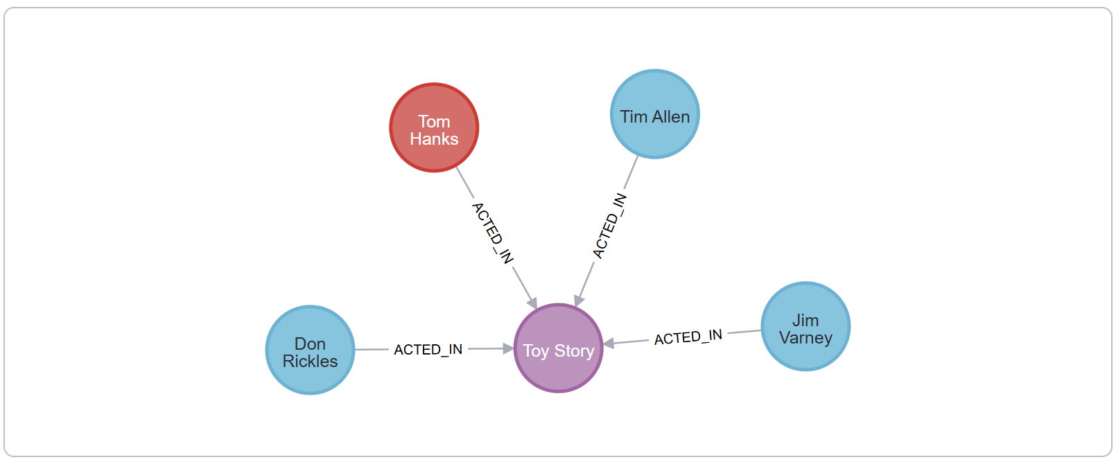
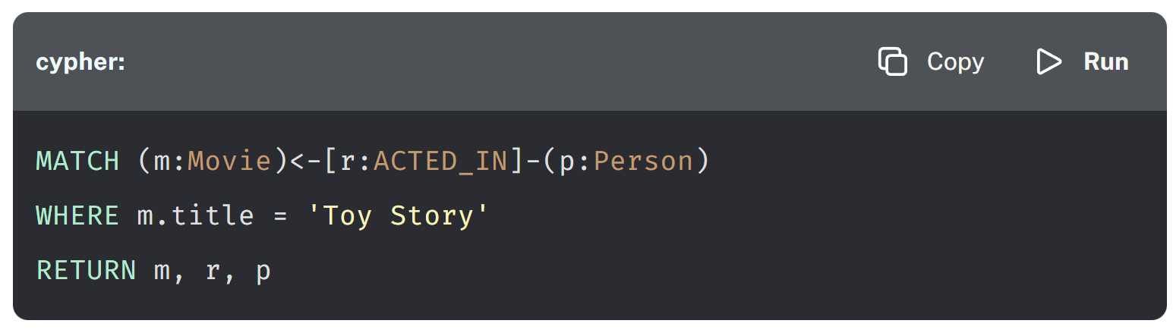
Find the Movie “Toy Story” and the People who Acted In that movie

Slide 29
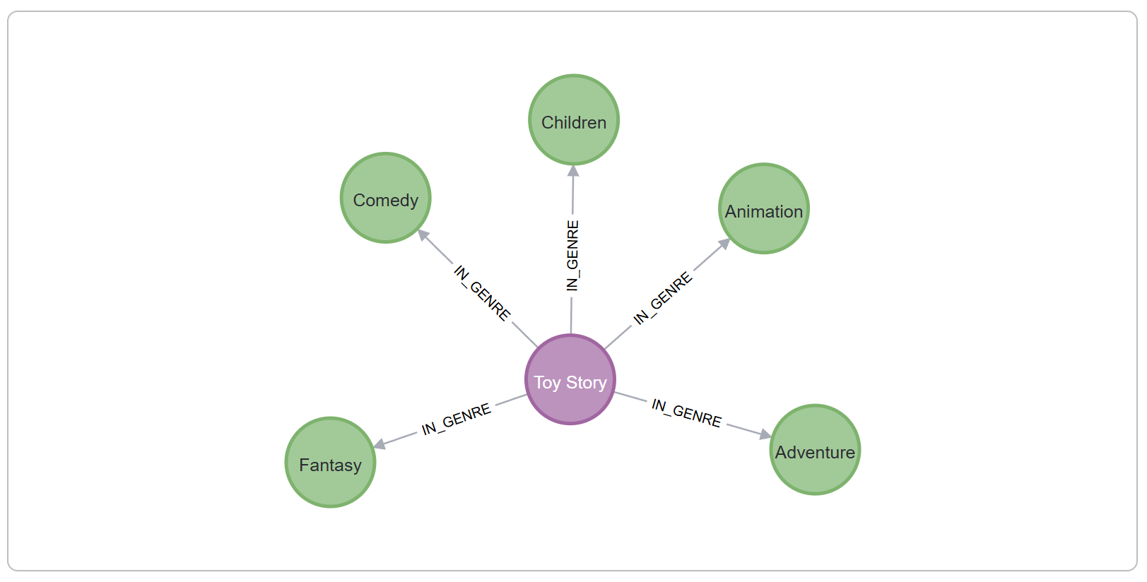
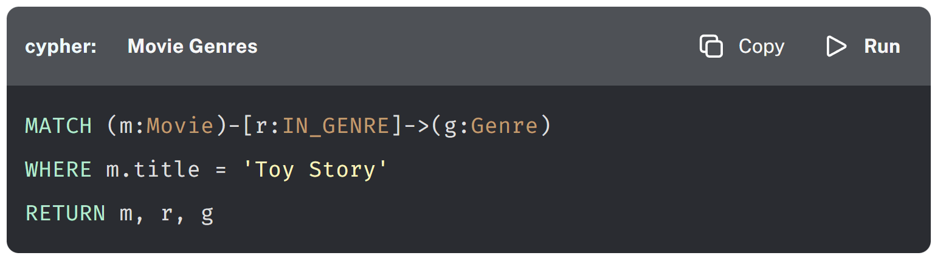
Find the Genres of the Movie “Toy Story”

Slide 30
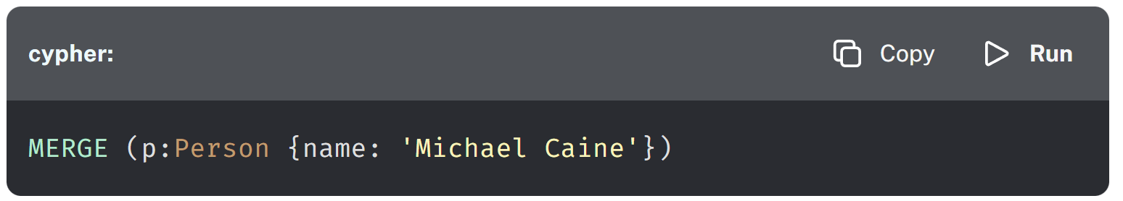
Creating Nodes
CREATE
MERGE

Slide 31
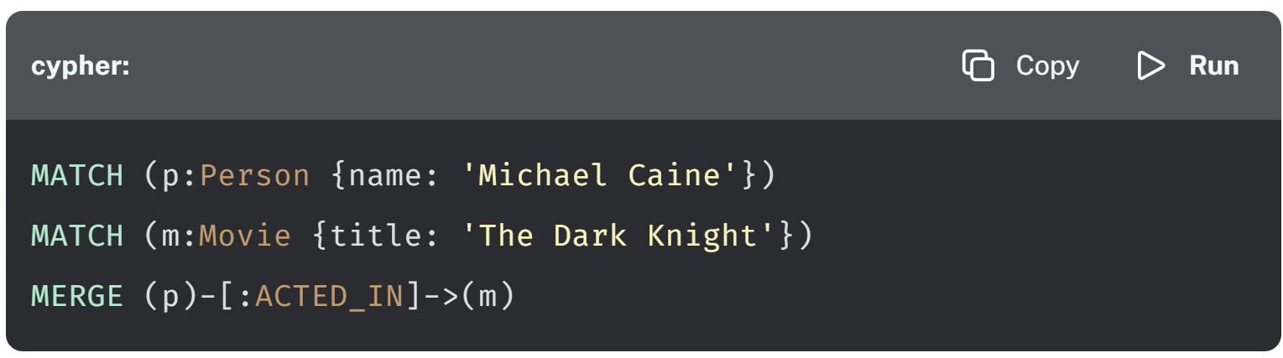
Creating Relationships

Slide 32
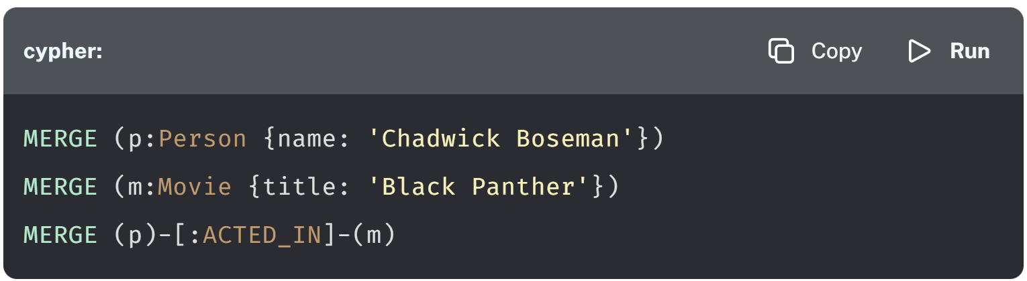
Creating Nodes and Relationships
Node Patterns: ()
Relationship Patterns: []

Slide 33
Creating Nodes and Relationships (Single Clause)
MERGE (p:Person {name: 'Emily Blunt'})-[:ACTED_IN]->(m:Movie {title: 'A Quiet Place'})
RETURN p, m

Slide 34
Common CYPHER Clauses
CREATE
MERGE
MATCH
WHERE
RETURN
DELETE
SET

Slide 35
A Social Network Example
// Find friends of friends who like similar movies
MATCH (user:Person {name: 'John'})-[:FRIENDS_WITH]->(friend)-[:FRIENDS_WITH]->(fof),
(user)-[:LIKES]->(movie:Movie)<-[:LIKES]-(fof)
WHERE user <> fof
RETURN DISTINCT fof.name, movie.title
ORDER BY fof.name, movie.title

Slide 36
A Recommendation Engine Example
// Find products purchased by customers who bought a specific item
MATCH (p:Product {name: 'Widget X'})<-[:PURCHASED]-(c:Customer)
-[:PURCHASED]->(rec:Product)
WHERE p <> rec
WITH rec, count(*) as frequency
RETURN rec.name, rec.price, frequency
ORDER BY frequency DESC
LIMIT 5

Slide 37
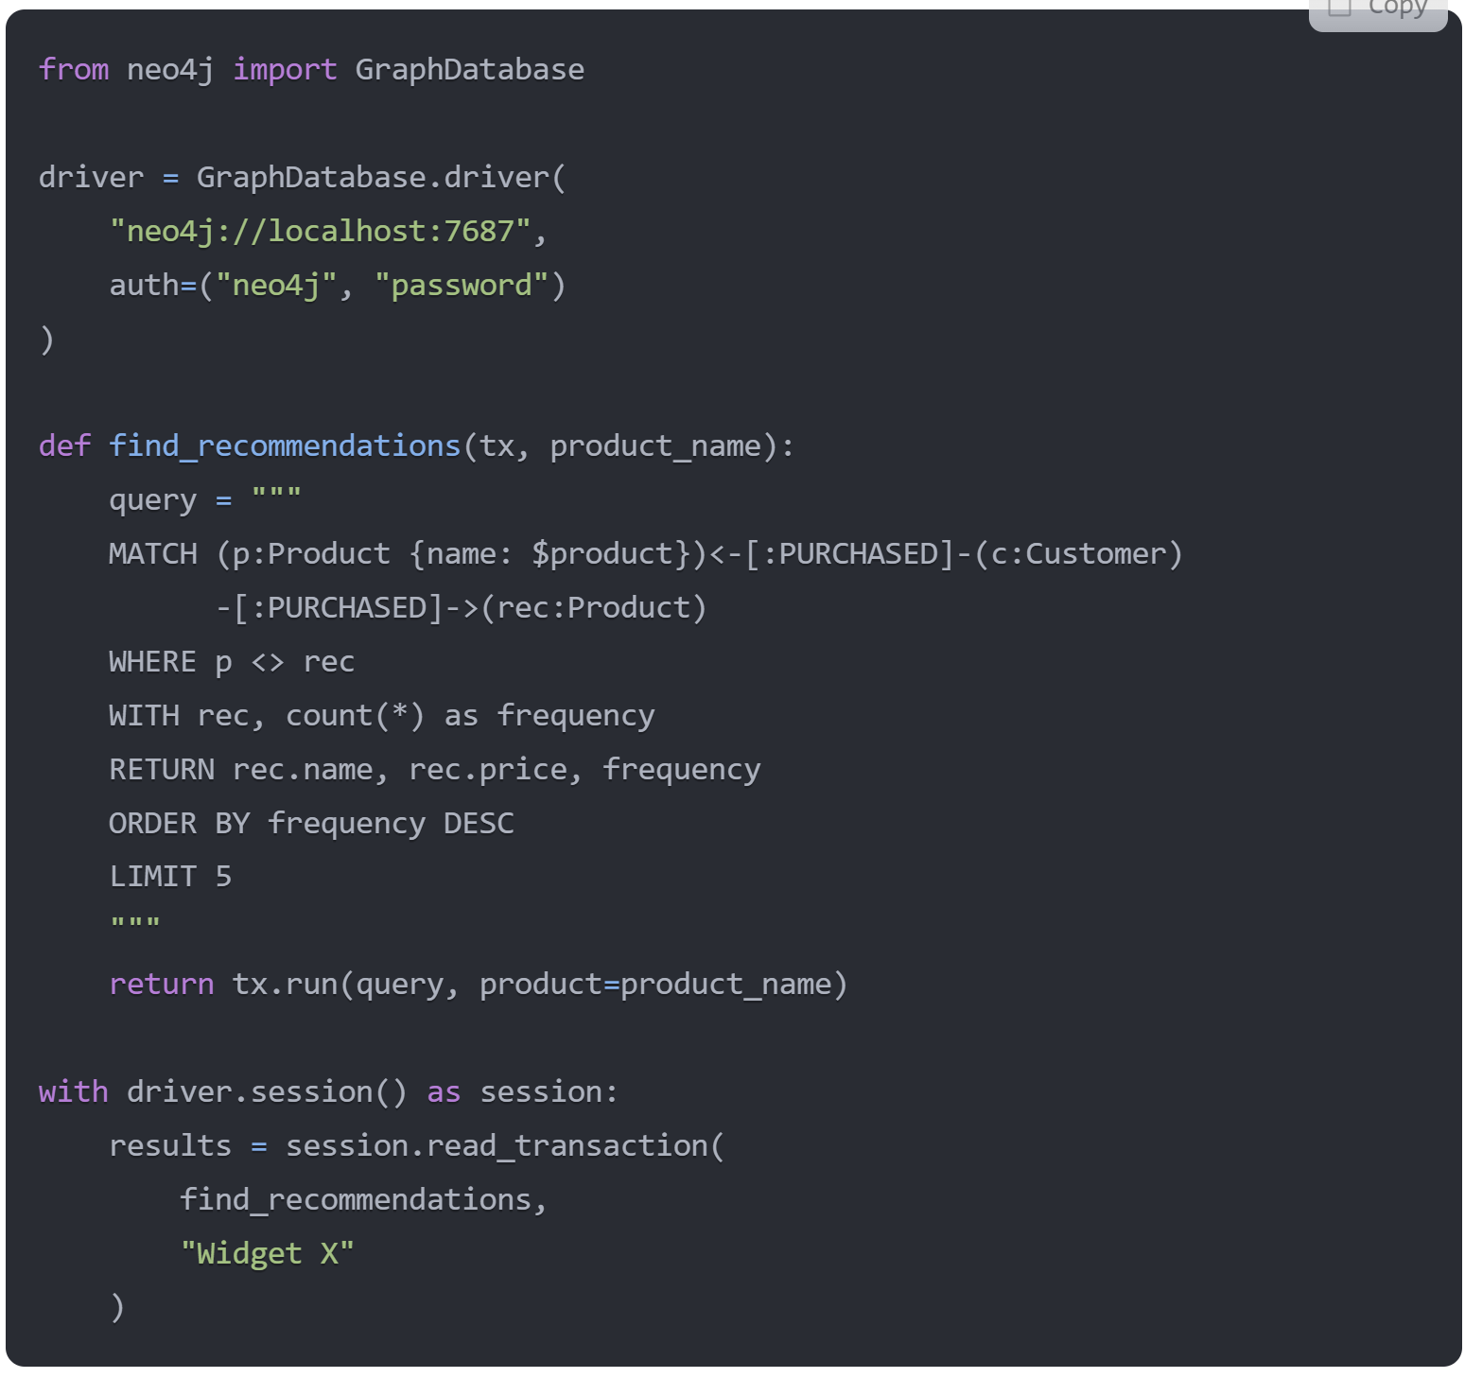

Slide 38

Summary of Key Points
Understanding Graph Databases
Graph databases allow for efficient data representation through nodes and edges, making them ideal for complex relationships.
Benefits of NEO4J
NEO4J offers advanced features like scalability, flexibility, and powerful querying capabilities tailored for graph data.
Graph vs Relational Databases
Graph databases differ from relational databases by focusing on relationships rather than tables, optimizing queries for connected data.
Cypher Query Language
Cypher is a powerful query language designed for querying graph databases, enabling intuitive data retrieval and manipulation.
Notes:
In summary, we have explored the concept of graph databases, highlighted the features and benefits of NEO4J, contrasted graph databases with relational databases, and discussed the Cypher query language with practical examples. This knowledge will aid in effectively utilizing graph databases.

Slide 39
Database Paradigms

Slide 40
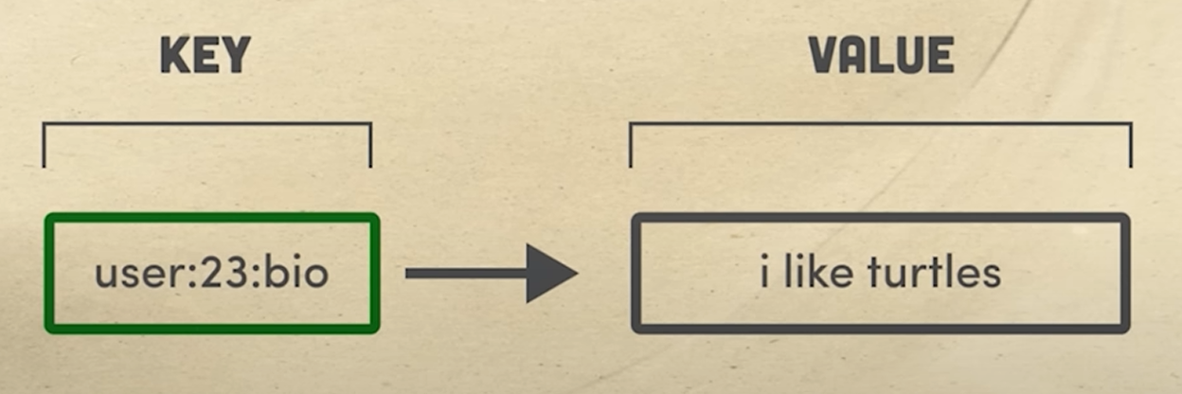
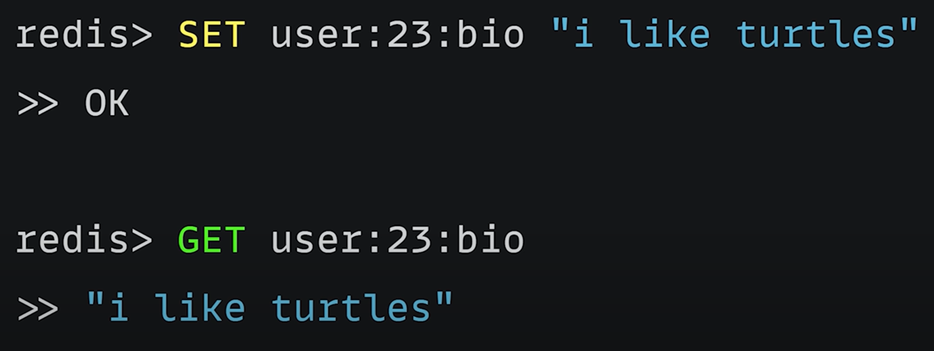
Key-Value (Redis, AWS Elasticache)
Set/Get
In-RAM
Less storage
MUCH faster
No
Queries
Joins

Slide 41
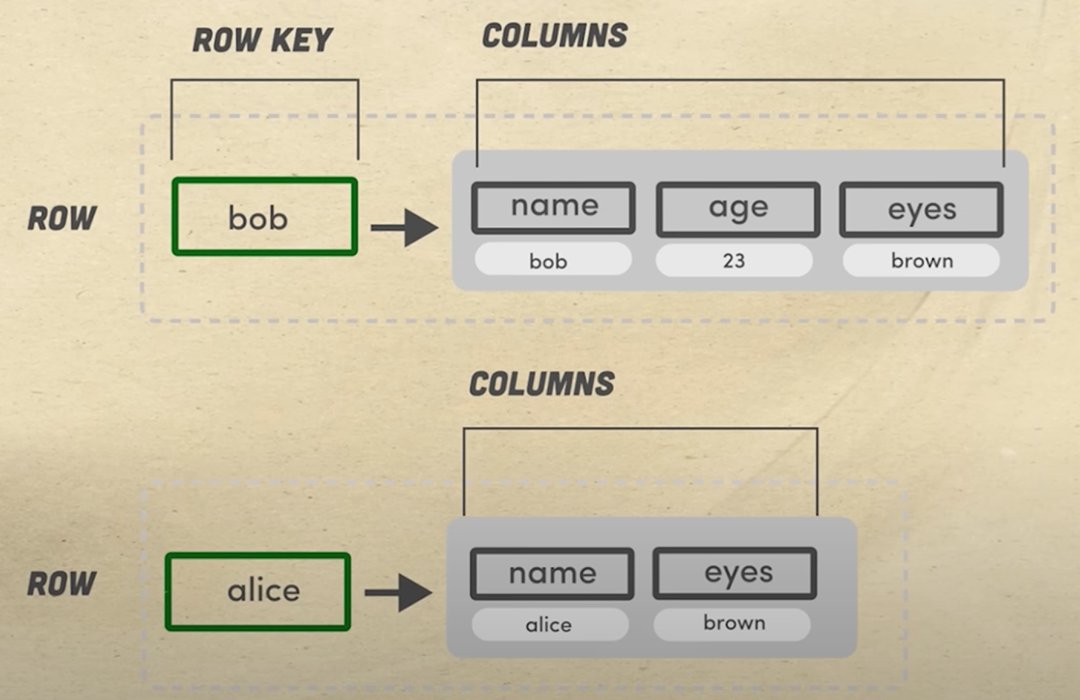
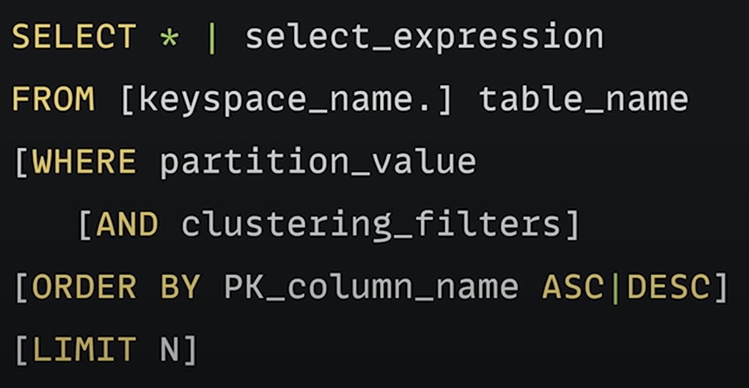
Wide Column (Cassandra, H-Base)
CQL language
More flexible
Scales Horizontally:
Time series
Histories
High-write / Low-read
No
Schema
Joins

Slide 42
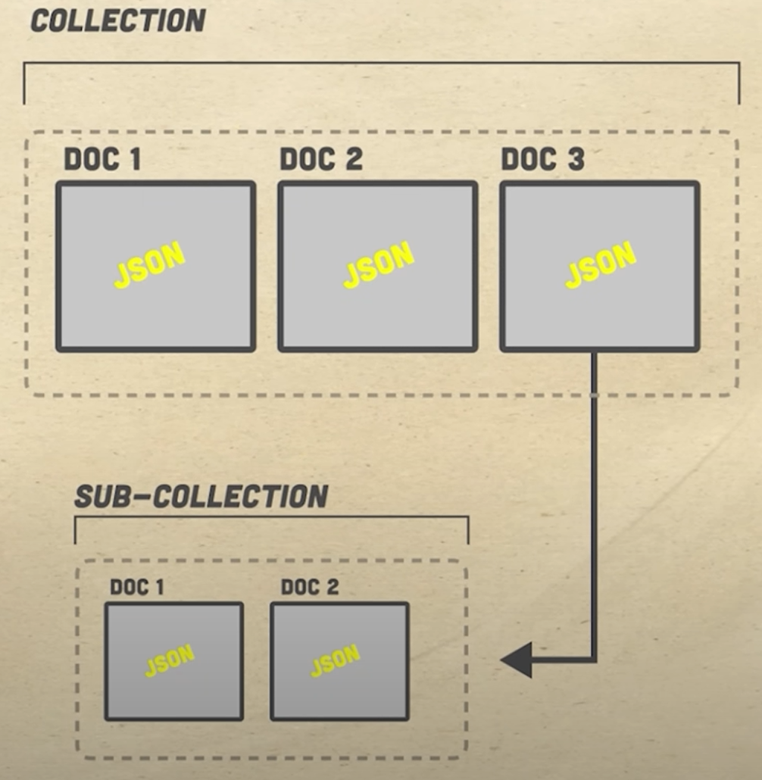
Document (MongoDB, DynamoDB)
Flexible
General purpose
Unstructured
High-read / Low-write
No
Schema
Joins

Slide 43
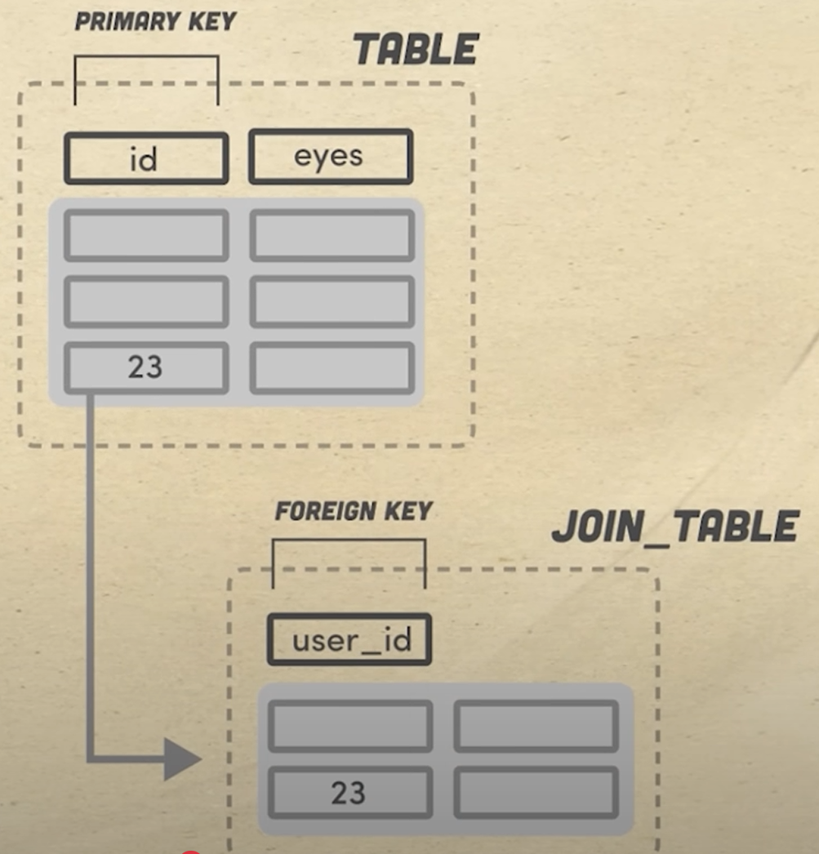
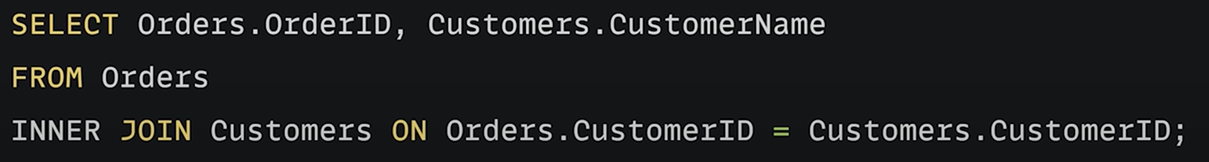
Relational (MySQL, RDS)
SQL language
Organized in smallest normal form
Requires schema

Slide 44
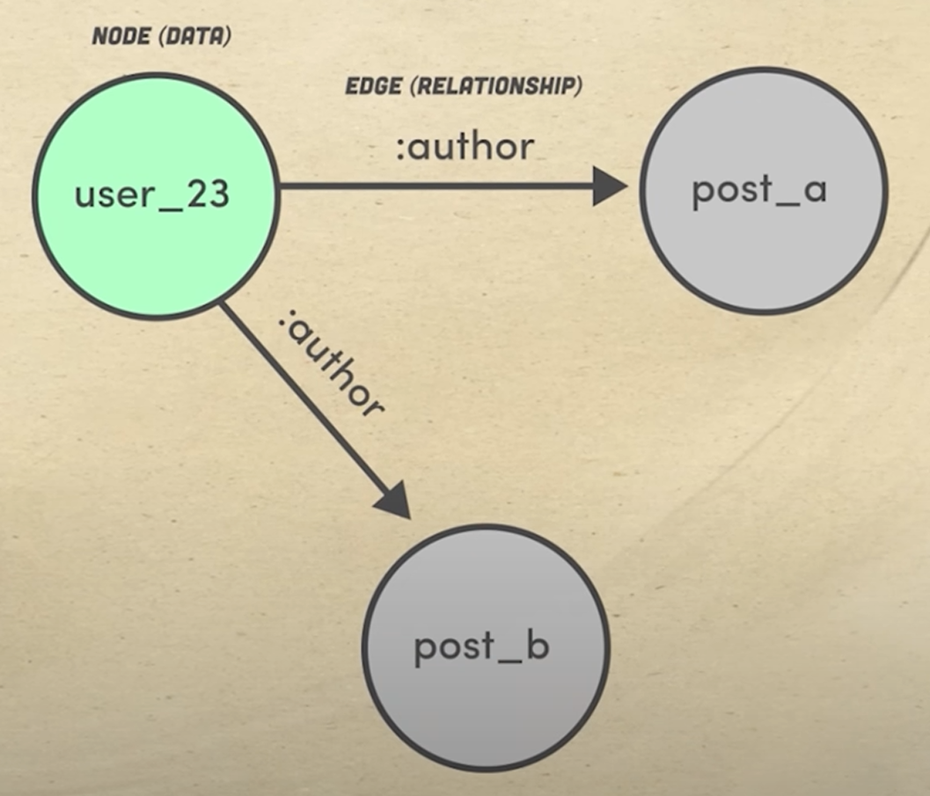
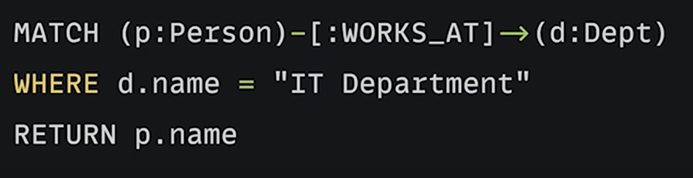
Graph (Neo4J, Neptune)
Cypher language
Scalable & Fast
Schema as data
No fact tables
(Reduces) joins

Slide 45
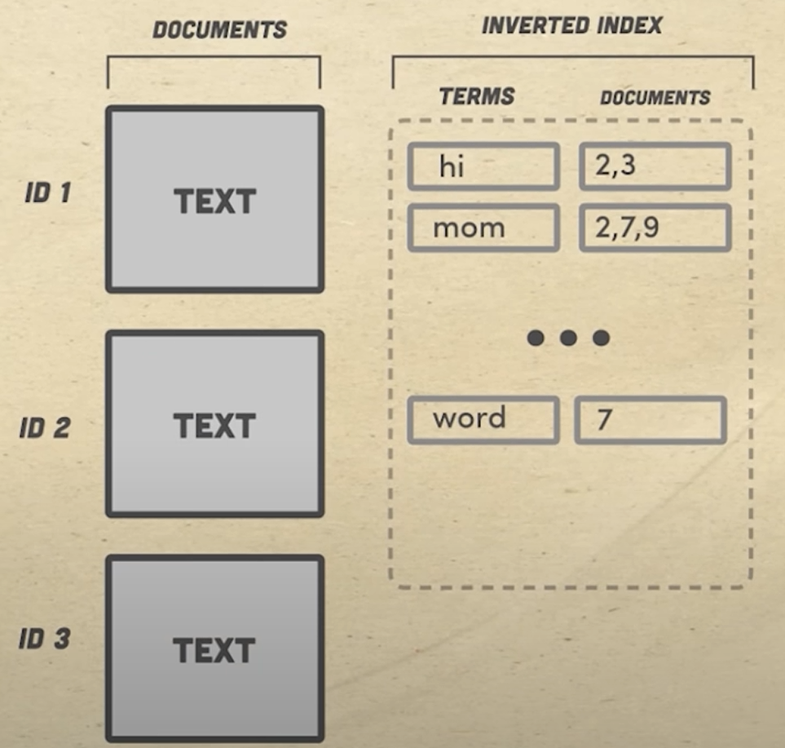
Search (Apache Lucene, ElasticSearch)
Indexed search
Scalable & Fast
Additional algorithms
Ranking results
Spelling correction
Lots of overheard

Slide 46
The Apache Software Foundation
A non-profit organization that supports many open-source software products
Uses a community-driven model of volunteer contributors
Runs an incubator program for potential new projects
Provides a legal framework to protect its projects and contributors
Core principles:
Community Over Code: Emphasizes that nurturing a community and its needs is more critical than the specific software being developed.
Meritocracy: Individuals gain influence based on their contributions and active participation.
Openness: Ensuring an open exchange of ideas and transparency in decisions.

Slide 47


A Tour of AWS Services

Slide 48
Compute

Slide 49
EC2 (Elastic Compute Cloud)
Description:
Scalable virtual servers in the cloud.
Multiple instance types for varying compute, memory, and storage needs.
Flexible pricing models (On-Demand, Reserved, Spot Instances).
Integration with Elastic Load Balancing and Auto Scaling.
Customizable OS and network configurations.
Use Cases:
Hosting web and enterprise applications.
Running batch processing and compute-intensive workloads.
Developing and testing software in customizable environments.

Slide 50
AWS Lambda
Description:
Event-driven, serverless compute service.
Automatically scales with the number of events.
Supports multiple programming languages.
No server management required.
Built-in fault tolerance and high availability.
Use Cases:
Real-time file or data processing (e.g., image resizing on S3 uploads).
Microservices architectures.
Automated backend services triggered by events.

Slide 51
AWS ECS (Elastic Container Service)
Description:
Fully managed container orchestration.
Supports Docker container deployments.
Integration with AWS services like IAM, CloudWatch, and ELB.
Options for serverless compute via AWS Fargate.
Simplifies scaling and management of containerized applications.
Use Cases:
Deploying microservices and containerized applications.
CI/CD pipelines.
Batch processing and machine learning model deployment.

Slide 52
AWS EKS (Elastic Kubernetes Service)
Description:
Managed Kubernetes service.
Fully compatible with standard Kubernetes tooling.
Simplifies deployment, management, and scaling of containerized applications.
Automates updates and patching of Kubernetes clusters.
Use Cases:
Running containerized applications using Kubernetes.
Migrating on-premises Kubernetes workloads to the cloud.
Managing complex microservices architectures.

Slide 53
AWS Fargate
Description:
Serverless compute engine for containers.
Eliminates the need to manage underlying infrastructure.
Works with both Amazon ECS and EKS.
Automatically scales container instances.
Simplifies pricing and deployment.
Use Cases:
Deploying microservices without managing servers.
Running batch jobs and event-driven container workloads.
Rapid scaling of containerized applications.

Slide 54
AWS Lightsail
Description:
Simplified virtual private servers (VPS) with pre-configured stacks.
Easy-to-use management interface.
Predictable monthly pricing.
Integrated networking and storage options.
Ideal for small-scale or prototyping workloads.
Use Cases:
Hosting small websites or blogs.
Quick deployments of development environments.
Simplified web applications and databases.

Slide 55
AWS Outposts
Description:
Brings AWS services, infrastructure, and operating models on-premises.
Fully managed hardware and software solutions.
Enables hybrid cloud architectures.
Low-latency access for local applications.
Consistent AWS APIs across on-premises and cloud.
Use Cases:
Hybrid cloud applications needing local data processing.
Regulated industries requiring on-premises data storage.
Extending AWS infrastructure into on-prem environments.

Slide 56
Analytics

Slide 57
Amazon Glue
Description:
Serverless ETL (Extract, Transform, Load) service.
Automated data discovery and schema inference.
Integrated Data Catalog for metadata management.
Supports both batch and real-time processing.
Use Cases:
Data integration and transformation for analytics.
Building data lakes and data catalogs.
Migrating and cleaning data for data warehouses.

Slide 58
Amazon Lake Formation
Description:
Simplifies the creation and management of data lakes.
Centralizes data cataloging and access control.
Automates data ingestion and transformation.
Provides fine-grained security and governance.
X`Integrates with analytics and machine learning services.
Use Cases:
Centralizing and managing large data repositories.
Simplifying data ingestion and cataloging.
Ensuring secure data access for analytics workloads.

Slide 59
Amazon Athena
Description:
Serverless, interactive query service.
Uses standard SQL to query data directly in Amazon S3.
No infrastructure or cluster management required.
Pay-per-query pricing model.
Supports a wide variety of data formats.
Use Cases:
Ad-hoc querying of S3 data.
Log analysis and data exploration.
Quick data insights without the need for a full data warehouse.

Slide 60
Amazon Redshift
Description:
Fully managed, petabyte-scale data warehouse.
Columnar storage and massively parallel processing.
SQL-based querying and integration with BI tools.
Automated backups and scaling.
Advanced query optimization techniques.
Use Cases:
Business intelligence reporting.
Large-scale data analytics and data warehousing.
Complex query processing on structured data.

Slide 61
Amazon Kinesis
Description:
Platform for real-time data streaming and analytics.
Supports data ingestion from multiple sources.
Provides tools for stream processing (Kinesis Data Streams, Kinesis Data Firehose, Kinesis Data Analytics).
Scalable and resilient architecture.
Integrates with other AWS analytics services.
Use Cases:
Real-time log processing.
IoT data ingestion and processing.
Real-time event monitoring and analysis.

Slide 62
Amazon Managed Streaming for Kafka (MSK)
Description:
Fully managed Apache Kafka service.
Simplifies the setup, scaling, and management of Kafka clusters.
Provides high throughput and low latency.
Integrates with various AWS data analytics tools.
Ensures data durability and security.
Use Cases:
Real-time data streaming and event processing.
Building data pipelines and message brokers.
Log aggregation and system monitoring.

Slide 63
Amazon QuickSight
Description:
Cloud-powered business intelligence and data visualization tool.
Interactive dashboards with real-time insights.
Machine learning-powered anomaly detection.
Scalable and pay-per-session pricing.
Easily integrates with various AWS data sources.
Use Cases:
Ad-hoc analysis and reporting.
Interactive data exploration for non-technical users.
Real-time business insights.

Slide 64
Amazon Data Pipeline
Description:
Orchestration service for moving and transforming data.
Supports scheduled and event-based data workflows.
Integrates with on-premises and cloud data sources.
Pre-built templates for common data processing tasks.
Visual monitoring and management of pipelines.
Use Cases:
Automating data movement between AWS services.
Periodic data processing and ETL jobs.
Data integration across diverse data stores.

Slide 65
Storage

Slide 66
AWS S3 (Simple Storage Service)
Description:
Scalable object storage with high durability and availability.
Multiple storage classes for cost optimization.
Supports lifecycle policies and versioning.
Integrated with a wide range of AWS services.
Highly secure with configurable access controls.
Use Cases:
Data lakes, backup and restore.
Static website hosting and file storage.
Large-scale data archival.

Slide 67
AWS S3 Glacier & Glacier Deep Archive
Description:
Low-cost archival storage designed for long-term data retention.
Multiple retrieval options (expedited, standard, bulk).
Highly durable and secure.
Cost-effective for infrequently accessed data.
Integrated with S3 lifecycle policies.
Use Cases:
Long-term backup and archival.
Compliance and regulatory data storage.
Historical data retention.

Slide 68
AWS EFS (Elastic File System)
Description:
Scalable file storage for use with EC2 instances.
Provides shared file access with low latency.
Automatically scales as files are added or removed.
Supports concurrent access from multiple instances.
Fully managed with high availability.
Use Cases:
Content management systems.
Shared storage for enterprise applications.
Development and testing environments.

Slide 69
AWS EBS (Elastic Block Store)
Description:
Persistent block-level storage for EC2 instances.
Variety of volume types (SSD and HDD) for performance tuning.
Provides snapshot and backup capabilities.
Highly available and scalable.
Integrated with AWS management and monitoring tools.
Use Cases:
Boot volumes and application storage.
High-performance transactional databases.
Data-intensive workloads requiring low latency.

Slide 70
AWS FSx
Description:
Fully managed file storage solutions with native Windows and Lustre options.
High-performance file systems optimized for compute-intensive workloads. (ML!)
Seamless integration with existing applications.
Scalable and cost-effective.
Supports data-intensive tasks such as high-performance computing (HPC).
Use Cases:
Windows-based enterprise applications.
High-performance computing and data analytics.
Shared file storage in hybrid environments.

Slide 71
Database

Slide 72
Amazon RDS (Relational Database Service)
Description:
Fully managed relational databases supporting multiple engines (MySQL, PostgreSQL, Oracle, SQL Server, MariaDB).
Automated backups, patching, and replication.
Scalable compute and storage options.
High availability with Multi-AZ deployments.
Secure with network isolation and encryption.
Use Cases:
Web and mobile applications.
Enterprise databases and transactional systems. (OLTP)
Development and testing of relational data applications.

Slide 73
Amazon Aurora
Description:
High-performance, fully managed relational database compatible with MySQL and PostgreSQL.
Up to 5x performance improvement over standard MySQL.
Automated scaling, backups, and replication.
High availability with fault-tolerant design.
Built-in security features.
Use Cases:
Enterprise-grade applications and SaaS solutions.
Complex transactional workloads.
High throughput and performance-critical applications.

Slide 74
Amazon DynamoDB
Description:
Fully managed NoSQL database with single-digit millisecond latency.
Seamless scaling to support millions of requests per second.
Supports both document and key-value data models.
Built-in security, backup, and in-memory caching with DAX.
Serverless with auto-scaling capabilities.
Use Cases:
Gaming, IoT, and real-time bidding applications.
Applications requiring rapid and consistent performance.
Serverless architectures with unpredictable workloads.

Slide 75
Amazon DocumentDB (with MongoDB Compatibility)
Description:
Managed document database service optimized for JSON data.
Fully compatible with MongoDB APIs.
Automated backups, scaling, and maintenance.
High availability with replication across multiple AZs.
Secure with encryption at rest and in transit.
Use Cases:
Content management systems and catalogs.
Applications with flexible, schema-less data requirements.
Rapidly evolving application data models.

Slide 76
Amazon Keyspaces (for Apache Cassandra)
Description:
Managed, serverless Cassandra-compatible database.
Supports massive scalability with high availability.
Fully managed with automated backups and patching.
Offers low latency performance.
Seamlessly migrates existing Cassandra workloads.
Use Cases:
Time-series and IoT applications.
Real-time data processing.
Applications requiring Cassandra’s flexible data model.

Slide 77
Amazon QLDB (Quantum Ledger Database)
Description:
Fully managed ledger database with an immutable transaction log.
Cryptographically verifiable history of changes.
Serverless and highly available.
Simplifies audit trails and compliance reporting.
Seamless integration with existing applications.
Use Cases:
Financial transaction processing.
Supply chain and audit applications.
Systems requiring transparent, tamper-proof data histories.

Slide 78
Machine Learning

Slide 79
AWS Sagemaker
Description:
Fully managed service for building, training, and deploying ML models.
Integrated Jupyter notebooks for data exploration.
Supports automated model tuning and debugging.
Built-in algorithms and pre-built containers.
Facilitates end-to-end ML workflows.
Use Cases:
Predictive analytics and recommendation engines.
Image recognition and natural language processing.
Deploying scalable machine learning models.

Slide 80
AWS Comprehend
Description:
Natural language processing (NLP) service.
Extracts sentiment, key phrases, and entities from text.
Language detection and topic modeling.
Scalable and highly accurate.
Integrated with other AWS data services.
Use Cases:
Customer feedback analysis.
Social media sentiment tracking.
Automated text categorization and content analysis.

Slide 81
AWS Rekognition
Description:
Deep learning–based image and video analysis service.
Detects objects, scenes, and faces in media.
Supports facial analysis and recognition.
Provides content moderation capabilities.
Real-time and batch processing options.
Use Cases:
Security and surveillance applications.
Content moderation and user verification.
Image and video indexing for search.

Slide 82
AWS Forecast
Description:
Time series forecasting service powered by machine learning.
Automates model selection and tuning.
Provides accurate demand and trend predictions.
Integrates with historical data from various sources.
Use Cases:
Demand forecasting and inventory planning.
Financial planning and risk assessment.
Capacity planning and resource allocation.

Slide 83
AWS Personalize
Description:
Real-time personalized recommendation service.
Leverages the same technology used by Amazon.com.
Fully managed end-to-end machine learning solution.
Customizable with user behavior and metadata.
Seamless integration with web and mobile applications.
Use Cases:
Product recommendations for e-commerce.
Personalized content delivery.
User engagement and retention strategies.

Slide 84
AWS Textract
Description:
Automatically extracts text, forms, and tables from documents.
Uses machine learning to identify and extract data.
No manual configuration or template setup required.
Supports a variety of document formats.
Easily integrates with other data processing workflows.
Use Cases:
Automating data entry from scanned documents.
Extracting information from forms and invoices.
Digitalizing paper-based records.

Slide 85
AWS Polly
Description:
Converts text into lifelike speech using deep learning.
Supports multiple languages and voices.
Real-time streaming and customizable lexicons.
Easy integration into applications and devices.
Use Cases:
Voice-enabled applications and virtual assistants.
Audiobook and media content generation.
Accessibility tools and language learning apps.

Slide 86
AWS Translate
Description:
Neural machine translation service.
Supports real-time translation across multiple languages.
Consistently improves with new data.
Seamlessly integrates with other AWS services.
Simple API integration.
Use Cases:
Globalizing content for international audiences.
Real-time translation in chat and support applications.
Multilingual document processing.

Slide 87
AWS Fraud Detector
Description:
Machine learning–powered service to detect fraudulent activities.
Automatically builds and deploys fraud detection models.
Continuously improves with new data.
Integrated with AWS data sources and workflows.
Real-time scoring and decision-making.
Use Cases:
Payment and transaction fraud detection.
Account takeover prevention.
E-commerce and financial services risk mitigation.

Slide 88
AWS DeepLens
Description:
Deep learning–enabled video camera for edge computing.
Runs computer vision models locally.
Integrated with Amazon SageMaker for custom model deployment.
Supports real-time video analytics.
Ideal for prototyping and educational purposes.
Use Cases:
Edge analytics and real-time video processing.
Prototyping computer vision applications.
Educational demonstrations in ML and AI.

Slide 89
Key TakeAways
Graph databases are an alternative to relational databases in some situations
Neo4J offers local, free services to get started with graph databases
Cypher is a query language for graph databases
There are multiple database paradigms
Choose the right tool
AWS (and other enterprise cloud service) offer many tools for almost any use case!

Slide 90
Next Time
Distributed Computing
Hadoop
MapReduce

